Slide 1
Glycolysis

Slide 2
Graded Quiz Question #1
How does insulin help glucose enter an adipocyte?
Active transport through GLUT1
Active transport through GLUT4
Passive transport through GLUT1
Passive transport through GLUT4

Slide 3
Graded Quiz Question #2
Which enzyme has a Km for glucose near the physiological range:
Glucokinase
Hexokinase
Phosphofructokinase
GLUT4
Notes:
Answer is glucokinase

Slide 4
Graded Quiz Question #3
Which of the following is a target for glucagon dependent regulation in the liver?
GLUT2
PFK1
PFK2
Hexokinase
Notes:
Answer is PFK2

Slide 5
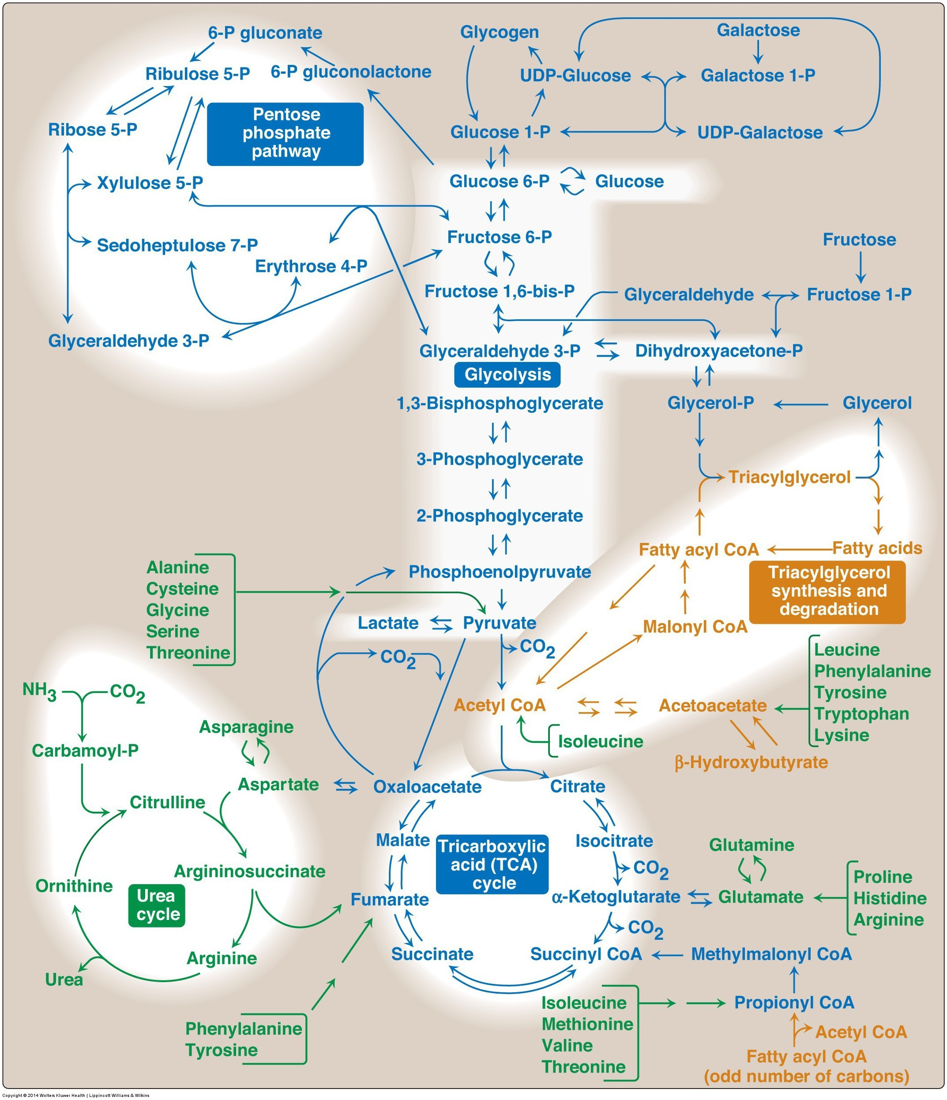
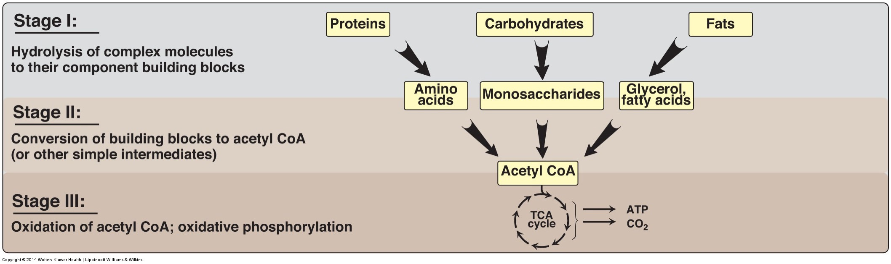
CHO Metabolism Overview
Sep 25: Glycolysis Sep 27: TCA Cycle and the Electron Transport Chain Oct 2: Glycogen Metabolism and the Pentose Phosphate Shunt Oct 4: Gluconeogenesis Oct 9: In-Class Review Oct 11: Exam 1

Slide 6
Glycolysis Learning Objectives
Describe the relative roles of glycolysis, gluconeogenesis, the TCA cycle as central nodes of nutrient metabolism.
Explain the enzymatic differences and tissue distributions of glucokinase vs hexokinase and why this is important.
Understand how ATP is produced from glycolysis, and the efficiency of aerobic vs non-aerobic glycolysis
Understand the key points of regulation of glycolysis and how these regulatory points are controlled, notably how glucokinase/hexokinase, PFK1 and PK are regulated including what signals are important in which tissues.
Describe the potential fates of pyruvate, and what dictates the next steps in its metabolism
Explain how non-glucose carbohydrates such as galactose and fructose enter glycolysis, and how their point of entry affects how they are regulated.

Slide 7
Fates of Glucose-6-Phosphate
GS: Glycogen syntase
PFK1: Phosphofructokinase 1
G6PDH: G6P Dehydrogenase

Slide 8
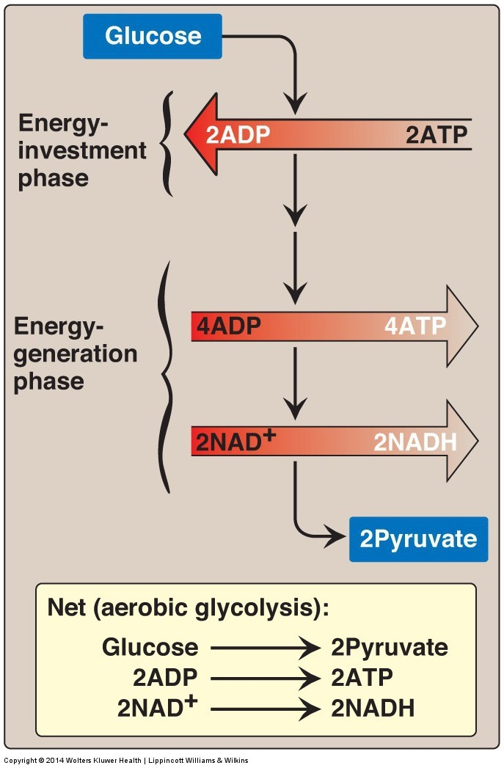
Glycolysis
Main pathway of monosaccharide degradation
Main tissue sites
Liver, muscle
Occurs in cytoplasm of the cell
Glucose conversion to two 3-carbon products: pyruvate
Generates 2 x ATP
Generates 2 x NADH => 5 ATP

Slide 9
Staring with the End
What happens to the pyruvate?
Aerobic Conditions
Becomes Acetyl-CoA
In presence of CHO but need energy -> TCA Cycle
In presence of CHO but don’t need energy -> Lipids
In absence of CHO (relevant for lipid oxidation)
Ketone Bodies (if OAA is absent)
Anaerobic conditions
Becomes lactate
Lactate goes to liver for reconversion back to glucose
Gluconeogenesis
if Acetyl-CoA is high
Pyruvate -> OAA -> Phosphoenolpyruvate
Notes:
Absent of CHO is mo

Slide 10
What is Glycolysis Accomplishing?
Think about muscle, liver and fat.
When would we want to activate or inactivate glycolysis in these tissues. Is it always the same?

Slide 11
Case Study – Tarui’s Disease
Mutation in phosphofructokinase 1
Rare ~100 cases
Autosomal recessive disease
Spend a moment thinking what would be the results of this disease

Slide 12
Case Study – Tarui’s Disease
Mutation in phosphofructokinase 1
Discuss some of these aspects among small groups
How would this affect the ability to use glucose for energy?
What would happen to glycogen levels?
What energy sources would be used instead?
What would happen to Fructose-2,6-bisphosphate levels?
Would it affect fructose utilization?

Slide 13
Case Study – Tarui’s Disease
Mutation in phosphofructokinase 1 in muscle only
Discuss some of these aspects among small groups
How would this affect muscle function?
Would this be different from a mutation in the liver PFK1 enzyme?
What would you recommend for treatment

Slide 14
Tarui’s Disease Summary
Symptoms | Treatments
Glycogen accumulation (GSDVII) | Genetic testing
Muscle pain and cramps | Avoid anaerobic exercise
Muscle tissue degradation | Low glucose/galactose
Low muscle tone (hypotonia) | High protein diets
Cardiomyopathy

Slide 15
How does glucagon/adrenaline inhibit PFK-2 activity in liver not muscle
Muscle doesn’t have PFK-2 activity
Glucagon/Adrenaline do not activate PKA in muscle
Muscle PFK-2 can’t be phosphorylated by PKA
There are no Glucagon/Adrenaline receptors in muscle

Slide 16
Tissue Specificity in PFK2 Regulation
Glucagon/Adrenaline can phosphorylate and inhibit Liver PFK2 but not Muscle PFK2
PFK-2 isoforms
Pourquoi?

Slide 17
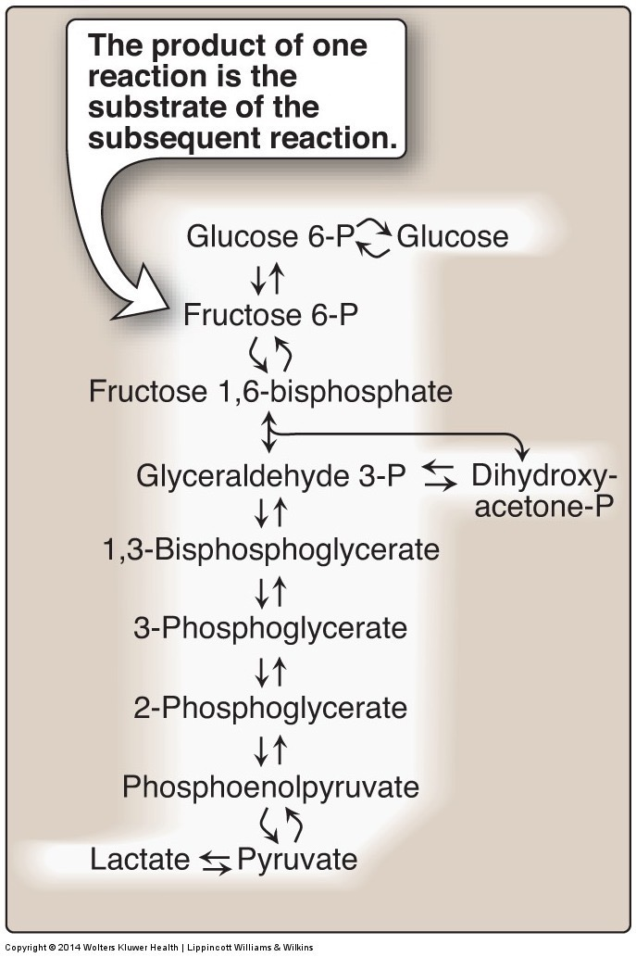
The third regulated step in glycolysis is Pyruvate Kinase
Substrate mediated ADP phosphorylation
Notes:
Other example of substrate mediated phosphorylation is phosphoglycerate kinase

Slide 18
How is Pyruvate Kinase Regulated

Slide 19
Post-Translational Regulation of Pyruvate Kinase
Alanine inhibition only in liver

Slide 20
Tissue Specific Regulation of Glycolysis Summary
Component | Liver | Muscle
Glucokinase/Hexokinase | Not inhibited by G6P | Inhibited by G6P
Phosphofructokinase | Inhibition of PFK-2 (regulates via F26bP) | PFK-2 not inhibited by phosphorylation
Pyruvate Kinase | Inhibition of PK by alanine and by phosphorylation | PK not inhibited by alanine or phosphorylation

Slide 21
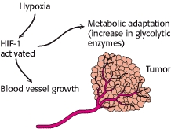
Transcriptional Regulation of GK/HK, PFK1 and PK Promotes Glycolysis
Hypoxia (HIF)
Carbohydrate sensing (ChREBP – L-PK)
Chronic glucagon (CREB - GK)

Slide 22
Glycolysis Net ATP
Note: NADH is energy equivalent to 3 ATP (from the ETC)
Energy Consuming Reactions:
Reactions 1: 1 ATP
Reaction 3: 1 ATP
Energy Generating Reactions:
Reaction 6: 1 NADH x 2 (3 ATP x 2 = 6 ATP)
Reaction 7: 1 ATP x 2 (2 ATP)
Reaction 10: 1 ATP x 2 (2 ATP)
Net Energy Gain:
4 ATP + 2 NADH minus 2 ATP = 8 ATP generated from glycolytic breakdown of glucose

Slide 23
TCA Cycle Net ATP

Slide 24
Energy Stress and Glycolysis
We have discussed 2 ways in which elevated low energy can activate glycolysis, do you remember what they are?
AMPK can regulate glycolysis, think of an example of how it could do this

Slide 25
Fructose and Galactose

Slide 26
Galactolysis
GALT
These will come up again when we talk about Glycogen Metabolism in a couple lectures

Slide 27
Galactolysis Summary
Galactose kinase phosphorylates galactose to galactose 1-phosphate
Galactose 1-P is coverted to Glucose 1-phosphate
G1P has different fates dependent on energy needs:
Glycogenesis
Glycolysis

Slide 28
Liver Fructose Metabolism
5
Skips the regulatory steps of Glucokinase and PFK2

Slide 29
Fructose Consumption and Metabolic Health

Slide 30
High Fructose Corn Syrup

Slide 31
Inherited Disorders of Fructose Metabolism
Fructokinase mutations
Fructose not trapped in the cell
Elevated fructose in the blood
Generally not pathological
Aldolase B mutations
Buildup of Fructose-1-phosphate
Impaired gluconeogenesis and glycogenolysis
High risk of hypoglycemia
What if fructokinase made Fructose-6-phosphate (it dosent)? How would that affect glycolysis?

Slide 32
Fructose metabolism
How is fructose metabolism different from glucose and galactose?
Think in terms of how it feeds into glycolysis
What metabolic checkpoints control glucose/galactose but not fructose?
What signals can regulate glucose/galactose but not fructose?

Slide 33
Fructolysis Summary
Fructose glycolysis in liver begins with FK
Bypasses two important regulatory step in glycolysis
Reaction 1 (glucokinase/hexokinase)
Reaction 3 (phosphofructokinase)
Pyruvate products may be shifted to pathways involved in fatty acid or cholesterol synthesis
Outside the liver hexokinase can phosphorylate Fructose to make F6P, but this is very inefficient

Slide 34
Disorders of Galatolysis
GALT (type I)
1:30,000-60,000
Galactose Epimerase (type II)
<1:100000
Galactose is trapped in the cell, builds up and causes developmental problems, cataracts, lethargy and liver damage
Avoid lactose and other galactose containing products

Slide 35
Glycolysis Learning Objectives
Describe the relative roles of glycolysis, gluconeogenesis, the TCA cycle as central nodes of nutrient metabolism.
Explain the catalytic differences and tissue distributions of glucokinase vs hexokinase and why this is important.
Understand how ATP is produced from glycolysis, and the efficiency of aerobic vs non-aerobic glycolysis
Understand the key points of regulation of glycolysis and how these regulatory points are controlled, notably how glucokinase/hexokinase, PFK1 and PK are regulated including what signals are important in what tissues.
Describe the potential fates of pyruvate, and what dictates the next steps in its metabolism
Explain how non-glucose carbohydrates such as galactose and fructose enter glycolysis, and how their point of entry affects how they are regulated.

